Slide 1
FM-index with Parallel Programming for DNA Sequencing Technology
組別：第36組
成員：程弘元、霍湛軒(Alvin)、簡維成

Slide 2
Outline
Introduction & Problem
Proposed solution
Evaluation
Related work
Contribution of each member
Conclusion

Slide 3
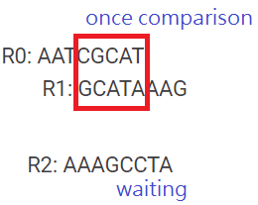

Introduction & Problem – DNA Sequencing
Because DNA are always very large size of data, it takes lots of time to doing the string overlap searching algorithms, maybe hours to days, even weeks.
String overlap searching algorithm’s time complexity is $O\left(l^{2}n^{2}\right)$, where $l$ is the length of DNA, and $n$ is the number of DNA.

Slide 4

Proposed solution – Burrows–Wheeler Transform (BWT) [1]
Burrows and Wheeler propose a method to reduce the time complexity to $O\left(ln\log{ln}\right)$, where $l$ is the length of DNA, and $n$ is the number of DNA.
This method need to generate a table, FM-index, which has three main parts:
1. Rotation
2. String Sorting
3. Counting

Slide 5
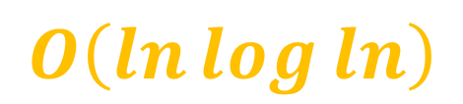

Proposed solution – Burrows–Wheeler Transform (BWT) [1]
Burrows and Wheeler propose a method to reduce the time complexity to $O\left(ln\log{ln}\right)$, where $l$ is the length of DNA, and $n$ is the number of DNA.
This method need to generate a table, FM-index, which has three main parts:
1. Rotation
2. String Sorting
3. Counting
bottleneck
$$O\left(ln\log{ln}\right)$$

Slide 6
BWT – 1. Rotation
ABCDE
BCDEA
for(int i=0;i<length-1;i++)
result[i]=source[i+1];
result[length-1]=source[0];
source = result;
CDEAB
DEABC
EABCD
Rotation times = string length

Slide 7
BWT – 2. String sorting
A < C < G < T
ATCGA
AATTG
TCGAA
AATTG
ATCGA
TCGAA
sorting

Slide 8
BWT – 3. Counting
Count{A,C,T,G}
AATTG
ATCGA
TCGAA
{0,0,0,1}
{1,0,0,1}
{2,0,0,1}

Slide 9
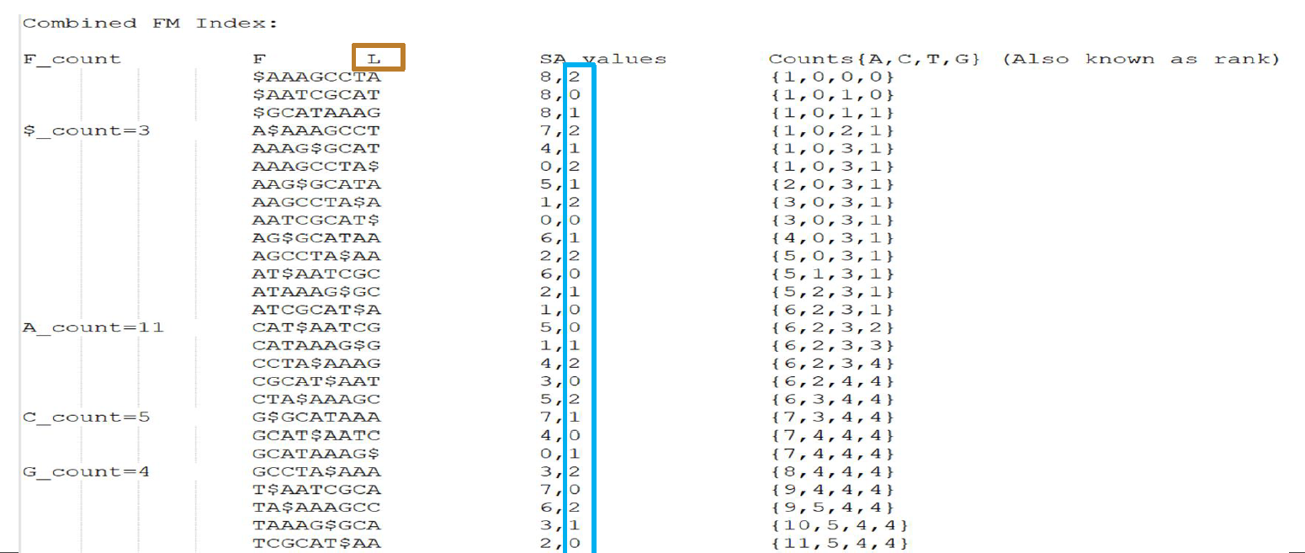
Proposed solution – FMIndex sample

Slide 10

Proposed solution – String sorting
We choose these four algorithms to leverage GPU parallelism and do analysis:
Serial bubble sorting: $O\left(l^{2}n^{2}\right)$
Serial merge sorting: $O\left(ln\log{ln}\right)$
Parallel merge sorting: $O\left(\frac{ln}{t}\log{ln}\right)$→$O\left(\log{ln}\right)$
Parallel bitonic sorting: $O\left(\frac{ln}{t}\log^{2}{ln}\right)$→$O\left(\log^{2}ln\right)$
$l$: the length of DNA
$n$: the number of DNA
$t$: the number of thread parallelly executing in GPU

Slide 11
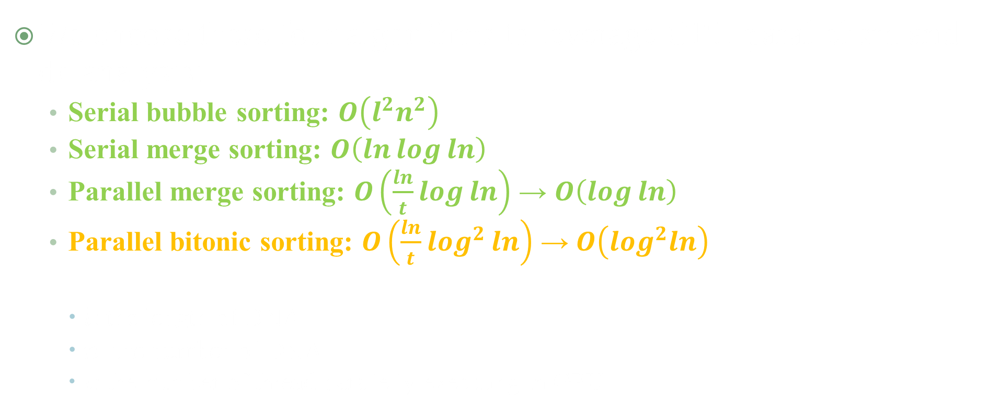
Proposed solution – String sorting
We choose these four algorithms to leverage GPU parallelism and do analysis:
Serial bubble sorting: $O\left(l^{2}n^{2}\right)$
Serial merge sorting: $O\left(ln\log{ln}\right)$
Parallel merge sorting: $O\left(\frac{ln}{t}\log{ln}\right)$ → $O\left(\log{ln}\right)$
Parallel bitonic sorting: $O\left(\frac{ln}{t}\log^{2}{ln}\right)$ → $O\left(\log^{2}ln\right)$
$l$: the length of DNA
$n$: the number of DNA
$t$: the number of thread parallelly executing in GPU

Slide 12
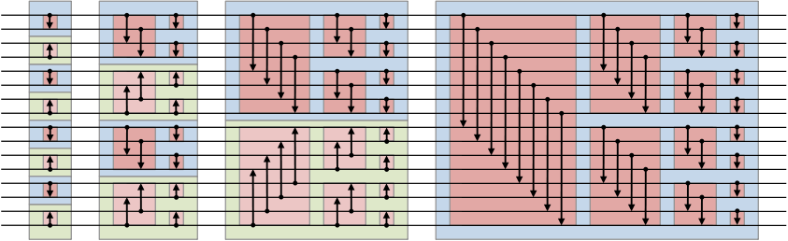
Parallel bitonic sorting – 16 input structure
picture source: Bitonic sorter – Wikipedia

Slide 13
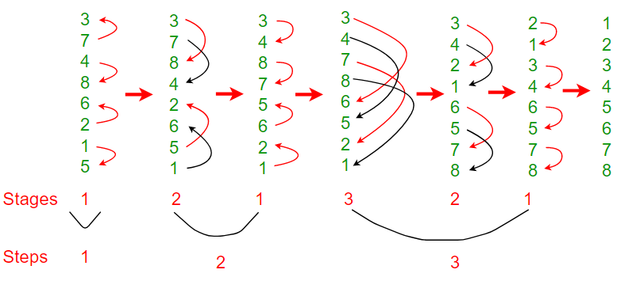
Parallel bitonic sorting – 8 input sample
picture source: Bitonic Sort - GeeksforGeeks

Slide 14

Parallel bitonic sorting – time complexity
$log\left(2\right)+log\left(2^{2}\right)+…+log\left(2^{n}\right)=\frac{logn(logn+1)}{2}$
→ $O\left(\log^{2}n\right)$
For our case, using parallel bitonic sorting: $O\left(\frac{ln}{t}\log^{2}ln\right)$
picture source: Bitonic sorter – Wikipedia

Slide 15
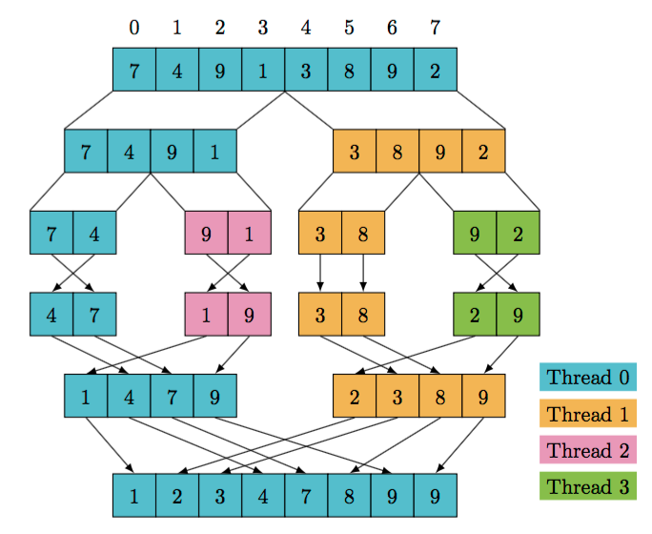
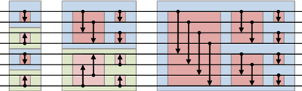
Parallel bitonic sorting is superior to Parallel merge sorting

Slide 16
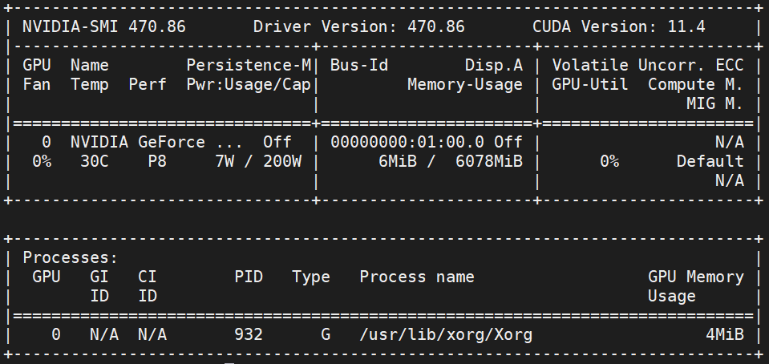
Evaluation – platform
Parallel Programming Server
Intel(R) Core(TM) i5-7500 CPU @ 3.40GHz
L1d cache: 128 KiB
L1i cache: 128 KiB
L2 cache: 16 MiB
L3 cache: 16 MiB
RAM 5.8G
4 CPUs one thread per core
NVIDIA GeForce GTX 1060 6GB

Slide 17
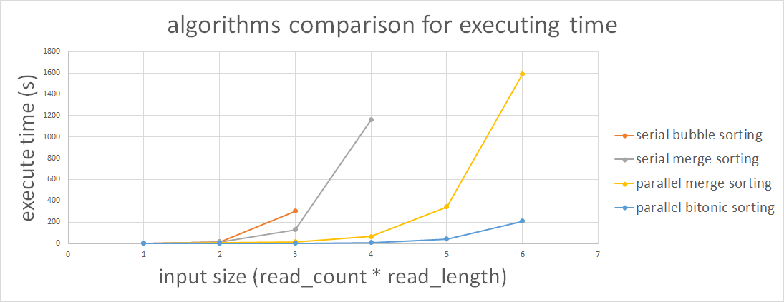
Evaluation – algorithms comparison
read_count*read_length | 64*127 | 256*127 | 1024*127 | 4096*127 | 16384*127 | 65536*127
 | 64 | 256 | 1024 | 4096 | 16384 | 65536
bubble serial | 1.02277 | 16.4744 | 304.047 | X | X | X
merge serial | 1.07901 | 14.0656 | 129.9912 | 1161.278 | X | X
merge parallel | 1.721344 | 4.904652 | 16.6148 | 66.7135 | 344.6667 | 1590.773
bitonic parallel | 0.298138 | 0.705776 | 2.217336 | 9.193602 | 43.199231 | 208.4297

Slide 18



Proposed solution – Burrows–Wheeler Transform (BWT) [1]
Burrows and Wheeler propose a method to reduce the time complexity to $O\left(ln\log{ln}\right)$, where $l$ is the length of DNA, and $n$ is the number of DNA.
This method need to generate a table, FM-index, which has three main parts:
1. Rotation
2. String Sorting
3. Counting
$$O\left(ln\right)$$
$$O\left(\frac{ln}{t}\log^{2}\left(ln\right)\right)$$
bottleneck
$$O\left(ln\log{ln}\right)$$

Slide 19
What is string rotation
for(int i=0;i<length-1;i++)
result[i]=source[i+1];
result[length-1]=source[0];
source = result;
ABCDE
BCDEA
CDEAB
DEABC
int thisX = threadIdx.x;
result[thisX]= source[thisX+1];
result[length-1]= source[0];
EABCD
Rotation times = string length

Slide 20
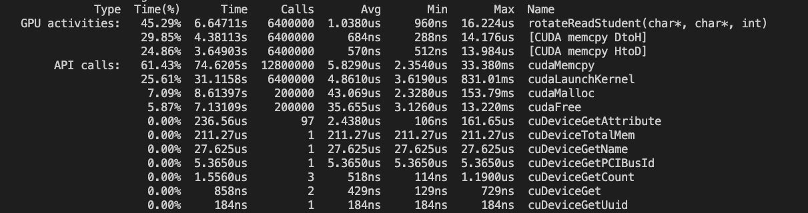
Number of string = 100000
Max thread=length of string
Length of string = 64
Sequence Version = 1.147653s

Slide 21
Improvement
Not depend on last rotation result
0th:ABCDE
result[i] = source[(i+j)%length]
int i = blockIdx.x * blockDim.x + threadIdx.x;
int j = blockIdx.y * blockDim.y + threadIdx.y;
char* row = (char*)((char*)result + j * pitch);
row[i] = source[(I+j)%length];
3rd:DEABC
[0] = [3], [1] = [4]
[2] = [1], [3] = [1]

Slide 22
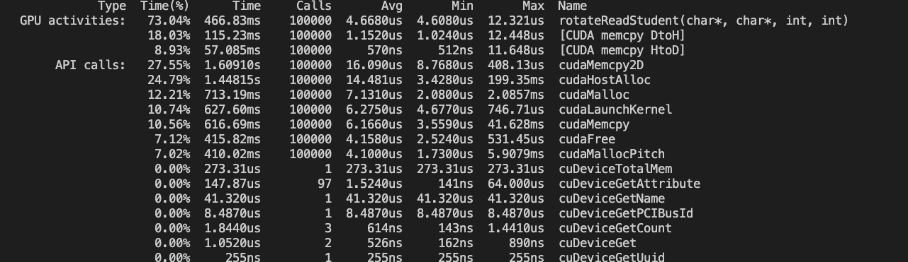
1D Version
2D Version

Slide 23
Real Situation
We have a lot of strings to rotation
Need one more dimension
AATCGCAT$
ATCGCAT$A
TCGCAT$AA
.
.
TA$AAAGCC
A$AAAGCCT
$AAAGCCTA
Flatten 3D array to 1D array and indexing
int i = blockIdx.x * blockDim.x + threadIdx.x;
int j = blockIdx.y * blockDim.y + threadIdx.y;
int k = blockIdx.z * blockDim.z + threadIdx.z;
result[i*length*length + j * length + k] = source[I * length + (j+k)%length];
AATCGCAT
GCATAAAG
AAAGCCTA

Slide 24
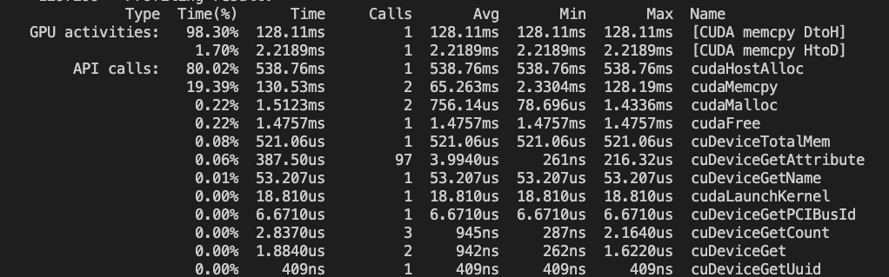
2D Version
3D Version

Slide 25
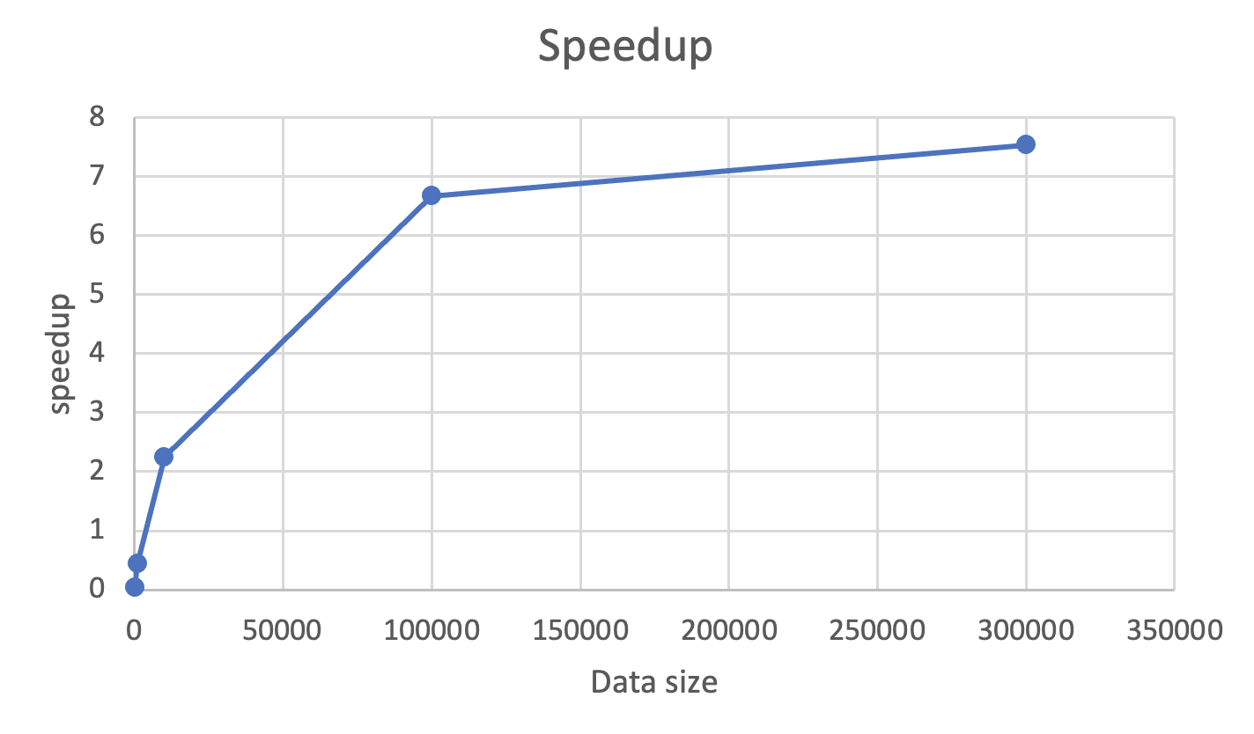
Speedup

Slide 26
Related work
“FindeR: Accelerating FM-Index-Based Exact Pattern Matching in Genomic Sequences through ReRAM Technology” [2]
F. Zokaee, M. Zhang and L. Jiang
In 2019 28th International Conference on Parallel Architectures and Compilation Techniques (PACT), 2019, pp. 284-295.
“Fast construction of FM-index for long sequence reads.”
Heng Li. 2014.
In Bioinformatics 30, 22 (08 2014), 3274–3275.
“Comparison of parallel sorting algorithms.” [3]
Darko Bozidar and Tomaz Dobravec
In CoRR (2015)

Slide 27
Contribution for each member – Just mention about main work
程弘元：
Merge sort with serial version and parallel version implement
String sorting speedup analysis
霍湛軒：
Rotation improvement
Rotation speedup analysis
簡維成：
Bitonic sorting with parallel version implement

Slide 28
Conclusion
FM-index has three main parts: Rotation, String sorting, Counting.
Bottleneck is at String sorting.
Our proposed solution can offer:
137x speedup compared with bubble sorting serial version
8x speedup compared with merge sorting parallel version.

Slide 29
Thank you for your attention.
It’s Q&A time.

Slide 30
Reference
[1] Michael Burrows and David Wheeler. 1994. A Block-Sorting Lossless Data Compression Algorithm. Technical Report. DIGITAL SRC RESEARCH REPORT.
[2] D. Nogueira, P. Tomás and N. Roma, "Burrows-Wheeler Transform based indexed exact search on a multi-GPU OpenCL platform," 2014 International Conference on High Performance Computing & Simulation (HPCS), 2014, pp. 31-38, doi: 10.1109/HPCSim.2014.6903666.
[3] Darko Bozidar and Tomaz Dobravec. 2015. Comparison of parallel sorting algorithms. CoRR abs/1511.03404 (2015).
[4] Markus J. Bauer, Anthony J. Cox, and Giovanna Rosone. 2013. Lightweight Algorithms for Constructing and Inverting the BWT of String Collections. Theor. Comput. Sci. 483 (April 2013), 134–148. https://doi.org/10.1016/j.tcs.2012.02.002
[5] Timo Bingmann and Peter Sanders. 2013. Parallel String Sample Sort. arXiv:1305.1157 [cs.DS]
[6] Heng Li. 2014. Fast construction of FM-index for long sequence reads. Bioinformatics 30, 22 (08 2014), 3274–3275. https://doi.org/10.1093/bioinformatics/btu541arXiv:https://academic.oup.com/bioinformatics/articlepdf/30/22/3274/7252262/btu541.pdf
[7] Chi-Man Liu, Ruibang Luo, and Tak-Wah Lam. 2014. GPU Accelerated BWT Construction for Large Collection of Short Reads. arXiv:1401.7457 [q-bio.GN]

